Slide 1
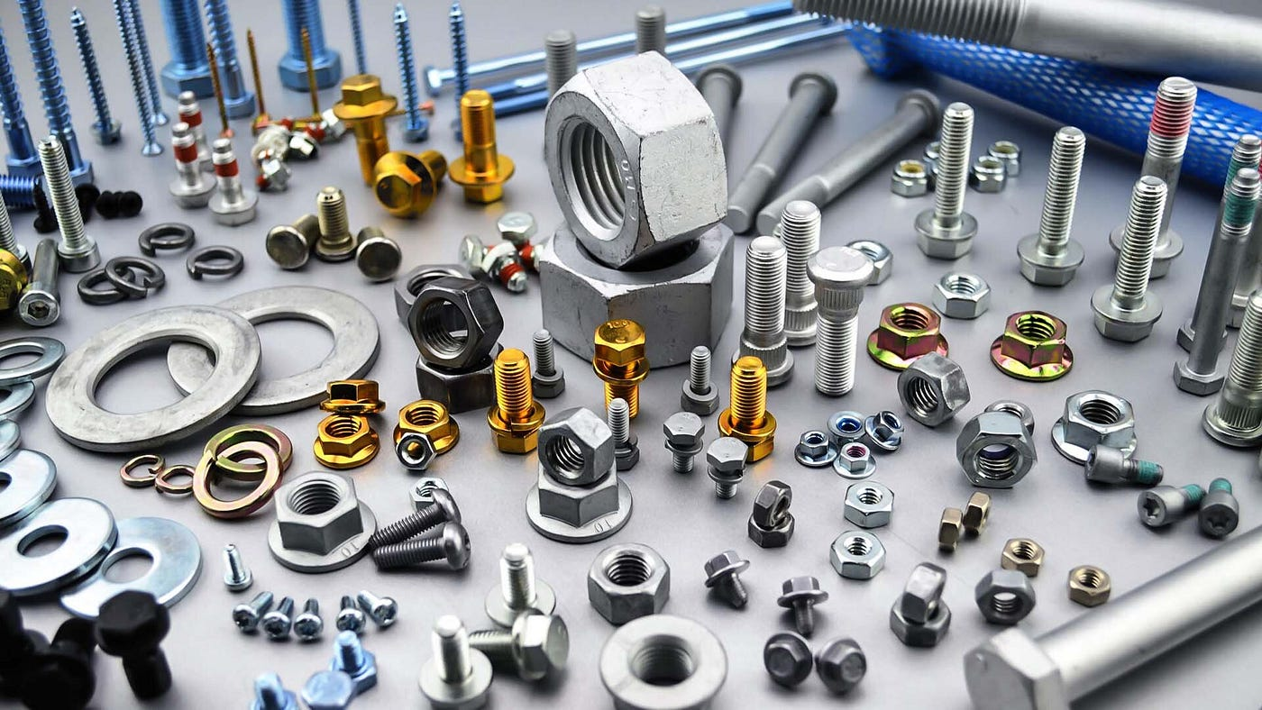
P.K. INDUSTRIES

Slide 2
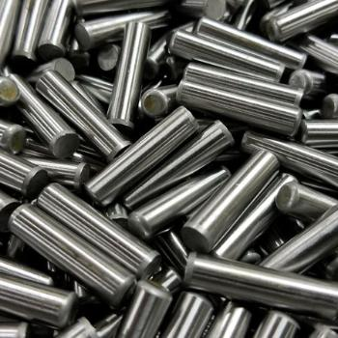
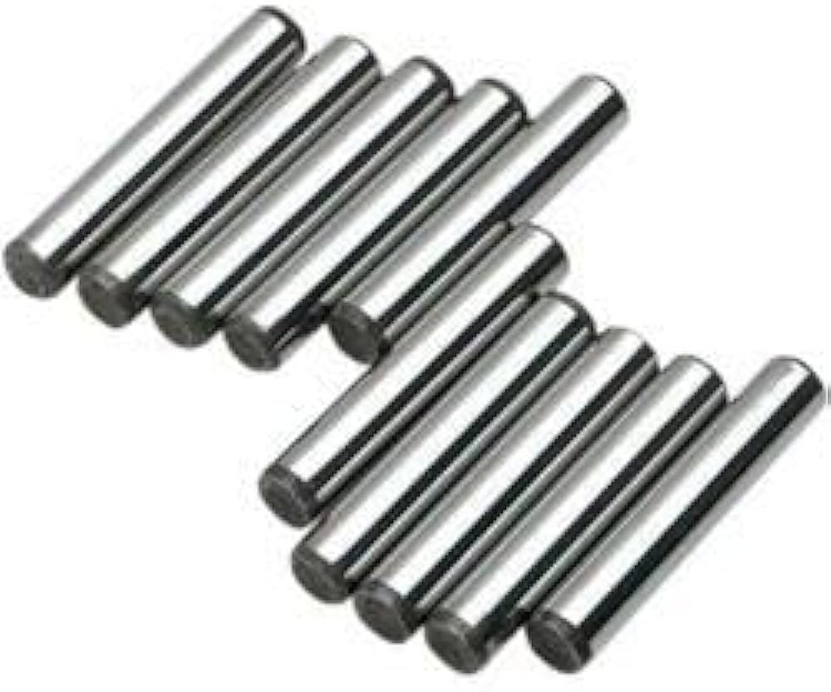
P.K.IND
P.K. INDUSTRIES
We Introducing our Brand P.K. INDUSTRIES with the experience of 25 years in the fastener industry. We are dealing in Solid Dowel Pin and Bolts like CSK, BUTTON HEAD, PH PAN HEAD, SHCS etc. PKI is specializes in the production of all kinds of Solid Dowel Pin and Bolts. The product are in conformity with ISO

Slide 3
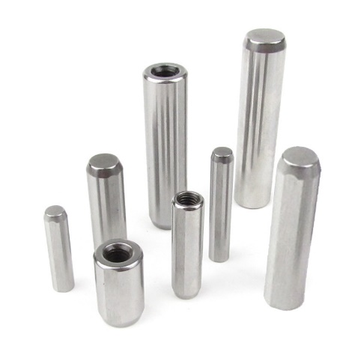
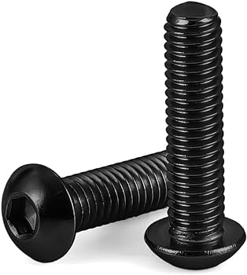
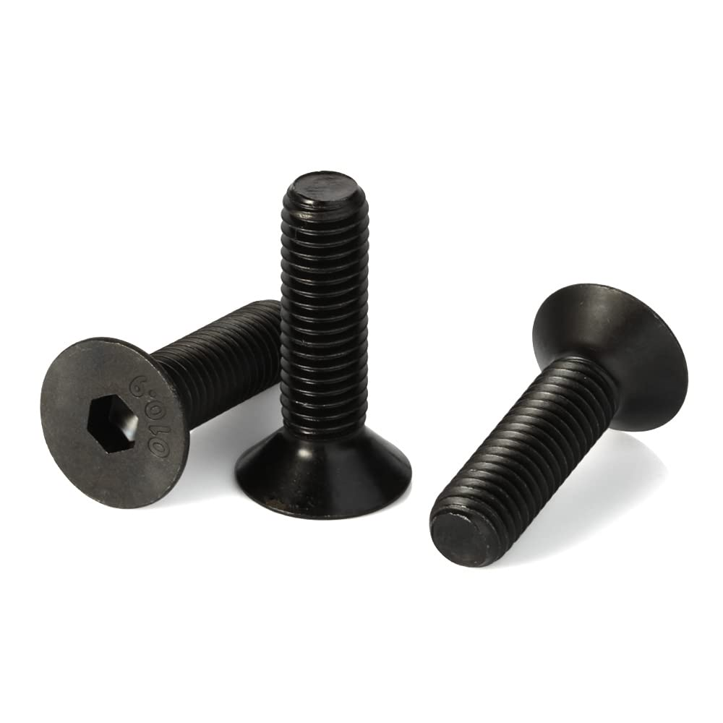
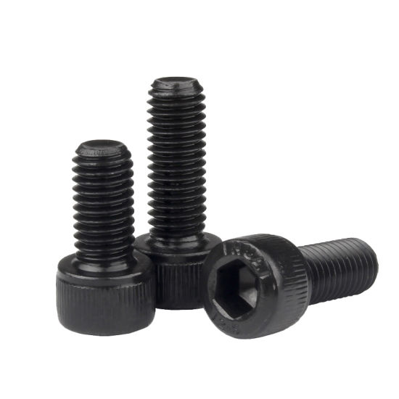
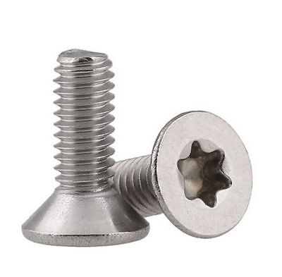
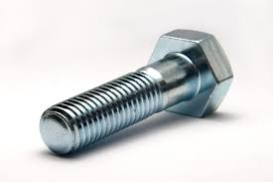
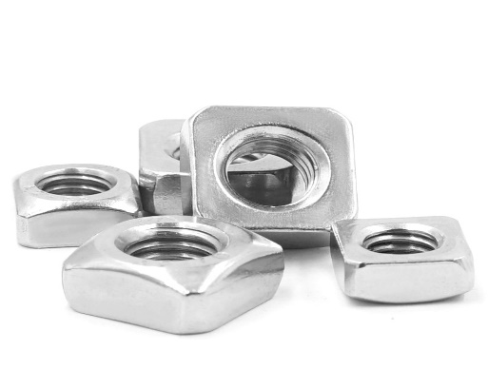
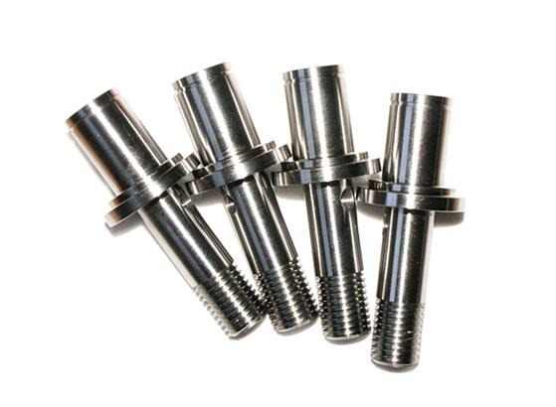
PRODUCTS OF PKI
DOWEL PIN
BUTTON HEAD CAP SCREW
FLAT HEAD SOCKET CAP SCREW
ALLEN BOLT
TORX BOLT
HEX BOLTS
SS SQUARE NUT
SHAFT SLEEVE

Slide 4


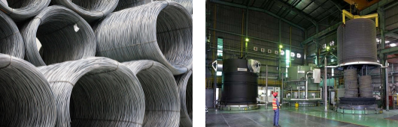
PKI sources of material directly from high quality steel manufacturers. All the material is thoroughly inspected before processing. Each grade is marked and provided with a proper identification tag. After the inspection the material is ready for processing (annealing & drawing). Wire Drawing is carried out to get the required wire size for cold forging the parts depending upon the size of fasteners to be manufactured. Each lot is identified with a unique heat number. The lots are 100% checked by its chemical & mechanical Properties.

Slide 5
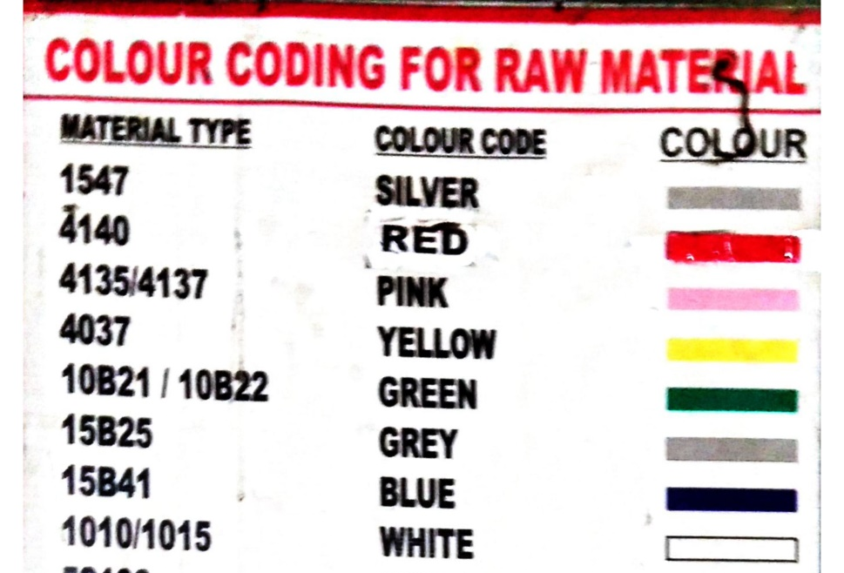
MANUFACTURING COMPETENCE
RAW MATERIAL GRADES
We use Round & Hexagon coils for manufacturing of bolts. We have in-house Raw Material storage capacity with racks for each lot with numbers. We have different raw materials storage of like 4140, 15B25, 10B21, EN-24, SCM-440 etc. We segregate all material with color coding, Tags, Racks for each Heat lot Number.

Slide 6

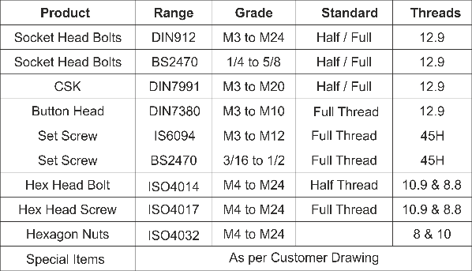
Range: (M3 to M10)
It is the process of forming the shape of a metal piece by external forces in ambient conditions. It is normally done at room temperature or near room temperature. At PKI , we do the cold forging on our fully automatic high speed multi station bolt formers. Our capacity includes a wide range of High Tensile Fasteners.

Slide 7






P.K.IND
MANUFACTURING AT PKI

Slide 8




PKI conducts rigorous quality assurance testing on all the fasteners it produces. Fasteners and Machine components are tested against stringent quality measures to guarantee performance and compliance for all the metrics based on industry standards or specific requirements.
We can furnish Dimensional Inspection Reports, Physical and Chemical Reports, and Certificates of Compliance upon request.
PKI has a QUALITY PLAN that ASSURES all parts will meet and exceed customer requirements. Our quality staff, with many years experience in quality control and engineering, has a complete understanding of all standards and specifications. Together with our "State of the Art" fastener testing equipment, you can rest ASSURED of receiving the PRECISE, QUALITYTESTED fastener for your specific application.

Slide 9
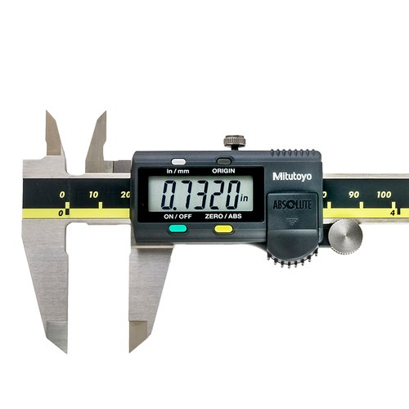
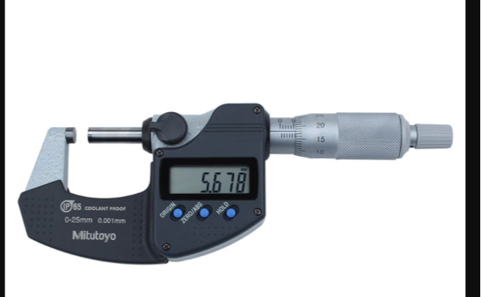
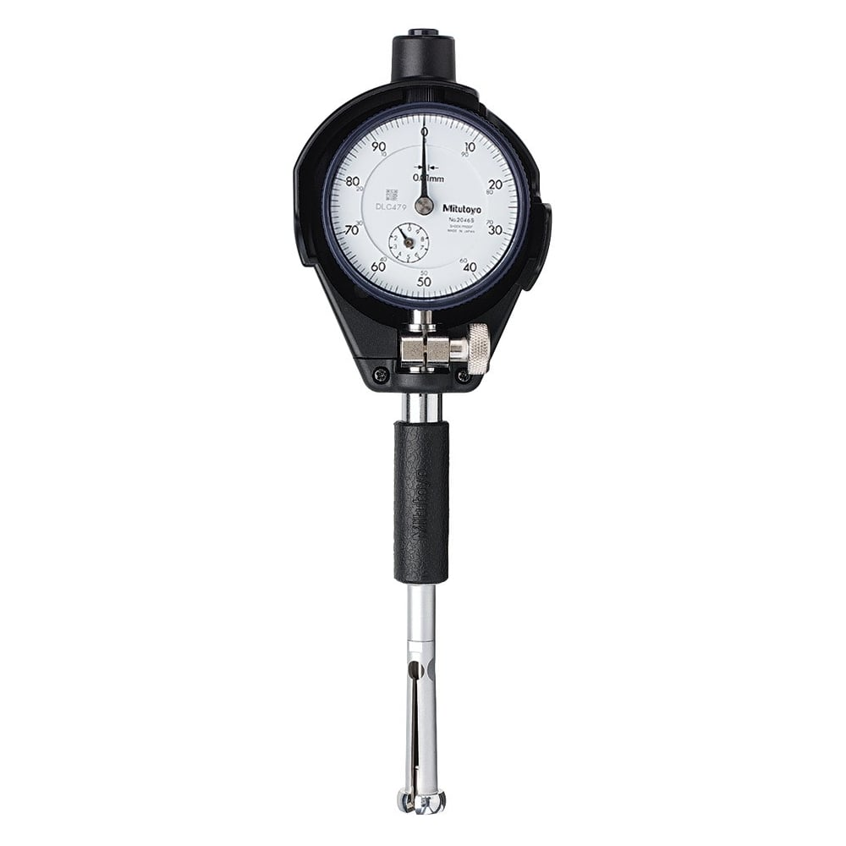
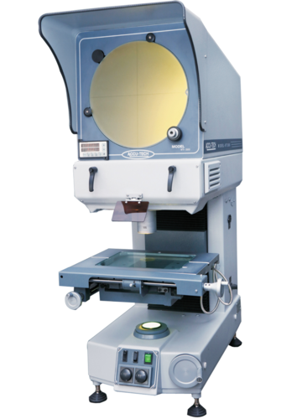
Quality Testing Equipments
We can furnish Dimensional Inspection Reports, Physical and Chemical Reports, and Certificates of Compliance upon request.

Slide 10
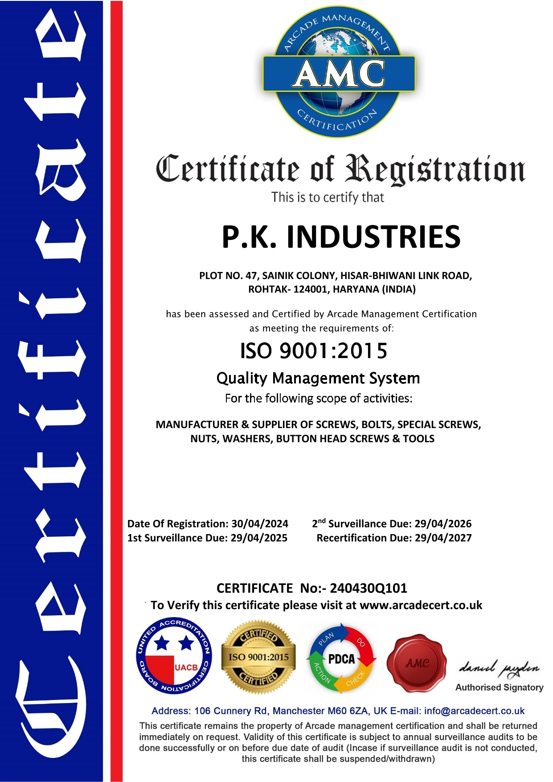
ISO CERTIFIED COMPANY

Slide 11
CUSTOMER COMPLAINT HANDLING
: Listen the customer concerned what they want to express it and give them immediate reaction to send person in 24 hr positively with in a particular area where our representative reach.
: Maintain Customer Complaint record
: Maintain corrective and Preventive action report
CUSTOMER COMPLAINT RECORD REPORT
P.K.I | P.K. INDUSTRIES
 | CUSTOMER COMPLAINT RECORD
Sr. No | RECEVING DATE | COMPLAINT NO | CUSTOMER NAME | STANDARD /DRW NO | Item Name | GRADE | COMPLAINT/ PROBLEM | INVOICE QTY | DEFECTIVE PART QTY | ACTION PLAN | Remarks
We can furnish Dimensional Inspection Reports, Physical and Chemical Reports, and Certificates of Compliance upon request.

Slide 12
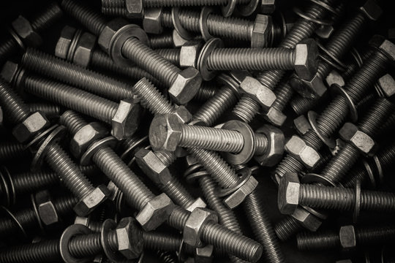
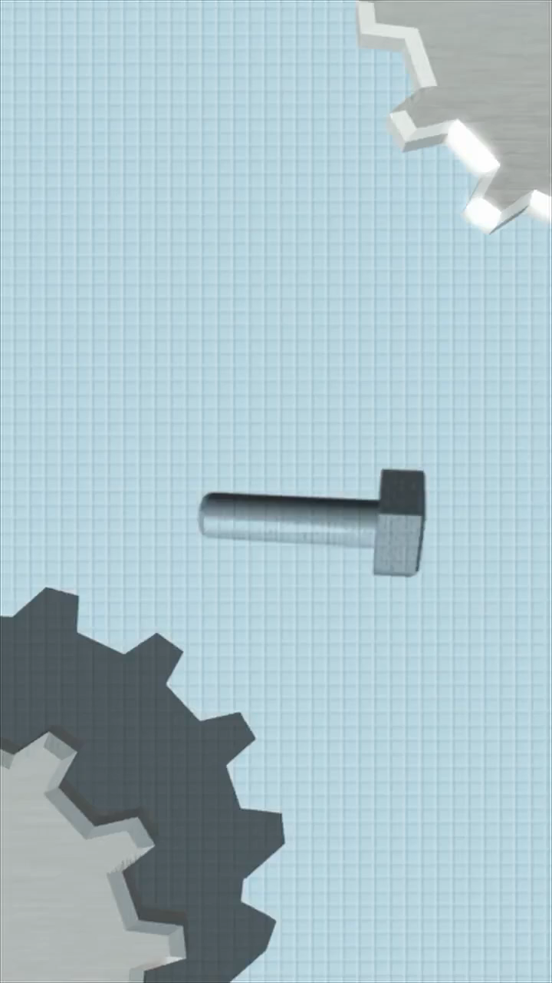
Few of our client
SUDHIR AUTOMOTIVE INDUSTRIES PVT LTD
MOHINDRA FASTENERS LTD
R.F.I INDIA
UNIVERSAL PRECISION SCREW
MICRON PRECISION SCREW
ARYA AGENCIES
VAISHALI AUTO INDUSTRIES
MICRON PRECISION SCREW
BK AUTO AUTOMATICS
SINGLA PRECISION SCREW
SHRI PRABHU FASTENERS
SHRI RAM AUTO INDUSTRIES

Slide 13



P.K. INDUSTRIES
Plot-47, SAINIK COLONY HISSAR BHIWANI LINK ROAD, ROHTAK, HARYANA 124001 (INDIA)
GST=06JOGPK4030B1ZD
Head Office
CONTACT - +91 7988442879, +91 9416337706
MAIL - pkindustriesrtk@gmail.com

